Slide 1
Git
GitHub

Slide 2
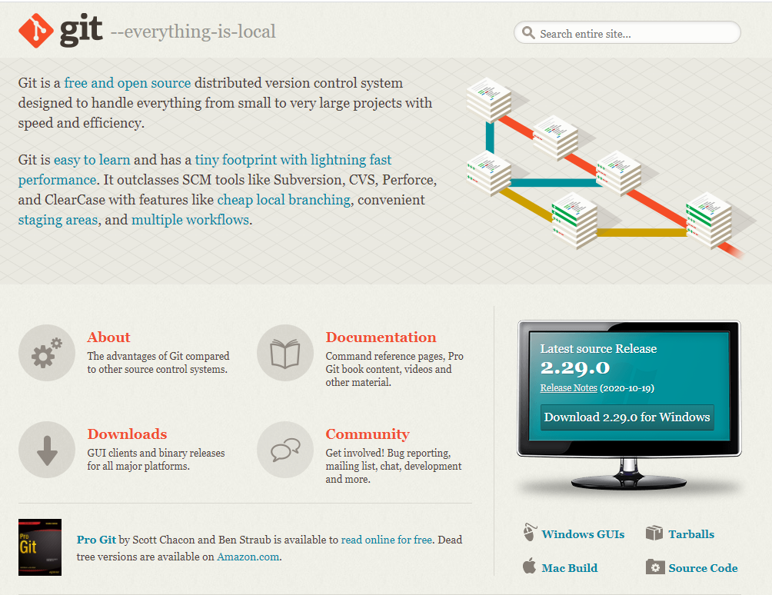
Github
GitHub
Launched 2008
2018 – Purchased by Microsoft
2019 – 57 millions repositories, over 1 million users
Version Control System – VCS
Source Code Management – SCM
Install
Windows
Mac
Linux
https://git-scm.com

Slide 3


Git - videos

Slide 4
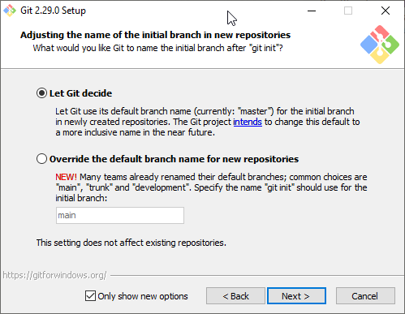
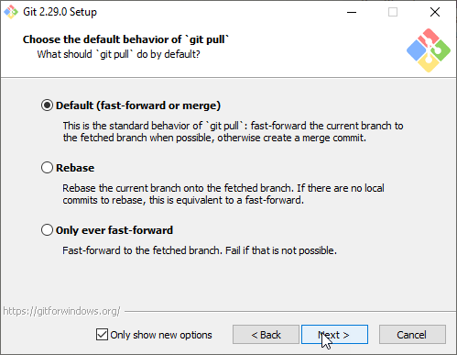
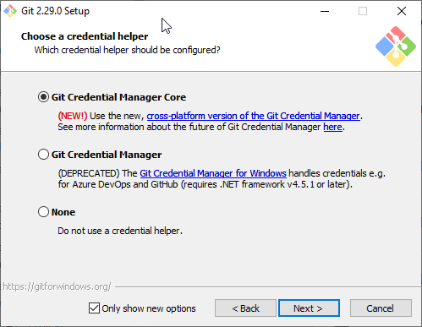
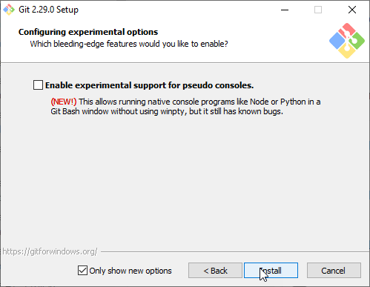
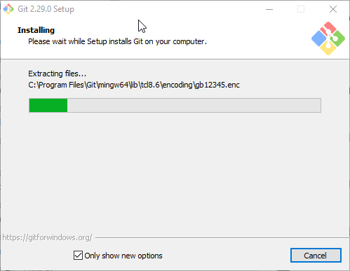
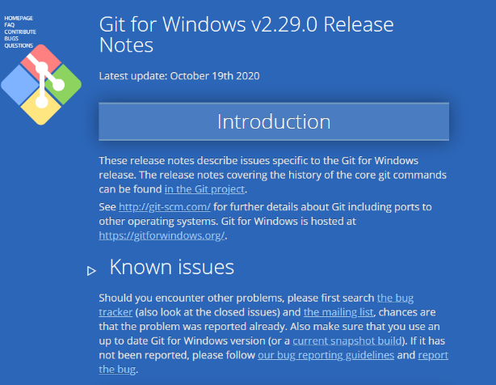
Install – git – Windows ☺
https://git-scm.com

Slide 5
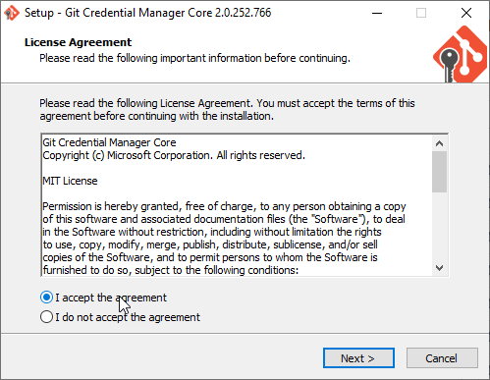
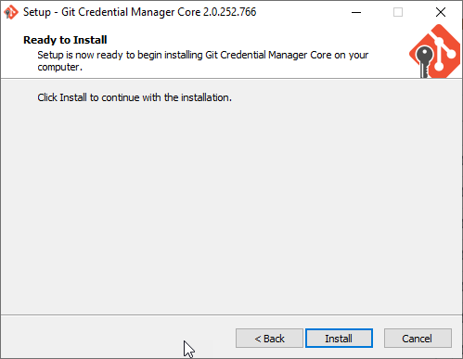
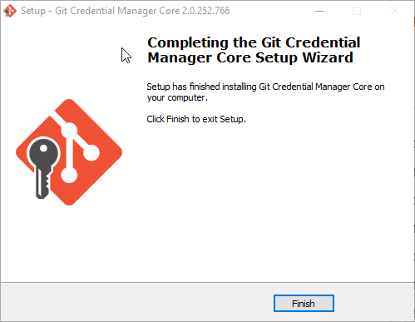
Git Credential Manager Core
Download - https://github.com/microsoft/Git-Credential-Manager-Core/releases/tag/v2.0.252-beta
After installation, Git will use Git Credential Manager Core and you will only need to interact with any authentication dialogs asking for credentials. GCM Core stays invisible as much as possible, so ideally, you’ll forget that you’re depending on GCM at all.

Slide 6
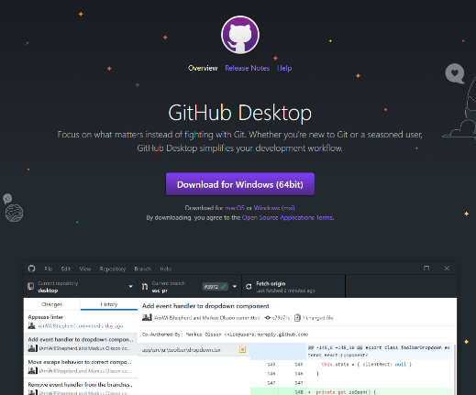
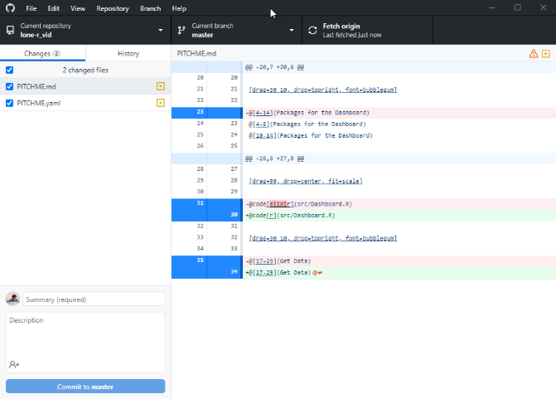
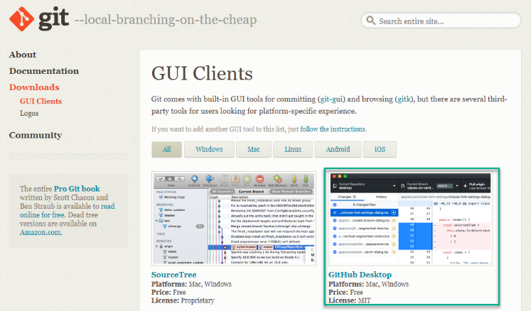
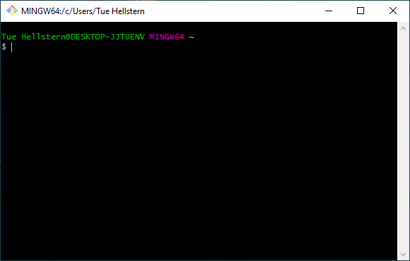
Git gui clients
https://git-scm.com/downloads/guis

Slide 7

Get going with git
Basic info
git config --global user.name "Tue Hellstern“
git config --global user.email “tueh@kea.dk”
Repository
git init MyNewProject
cd MyNewProject
create file1.txt (Notepad file1.txt)
git add file1.txt
git commit –m “Mit første commit”

Slide 8
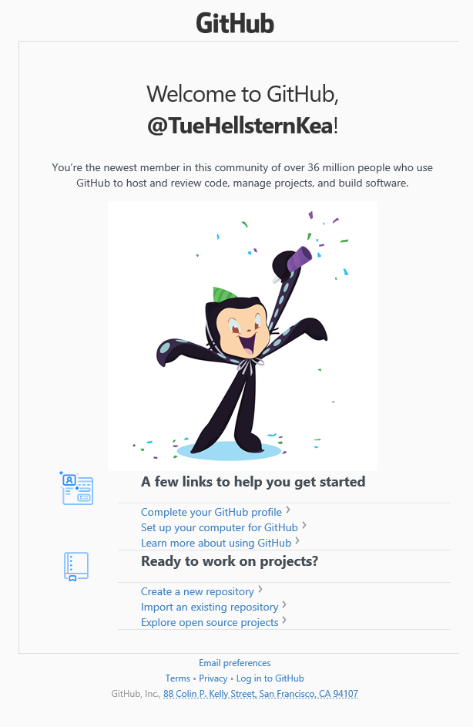

Create user acount

Slide 9
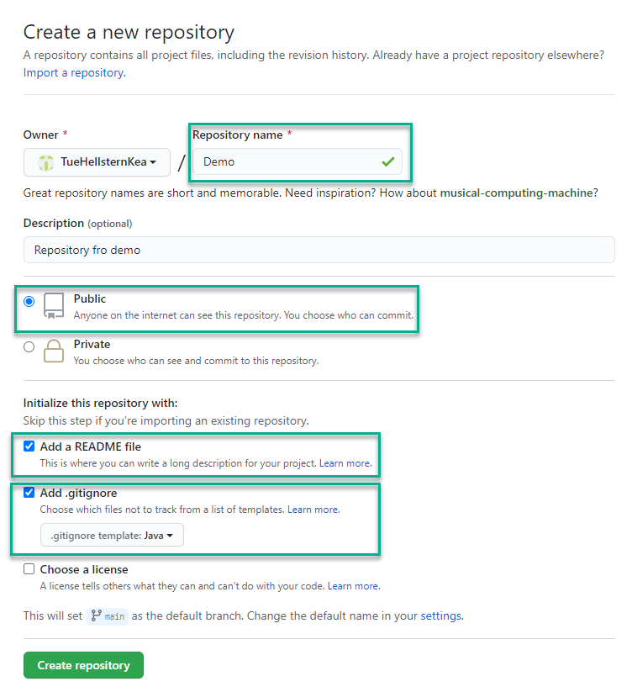
Create a new repository

Slide 10
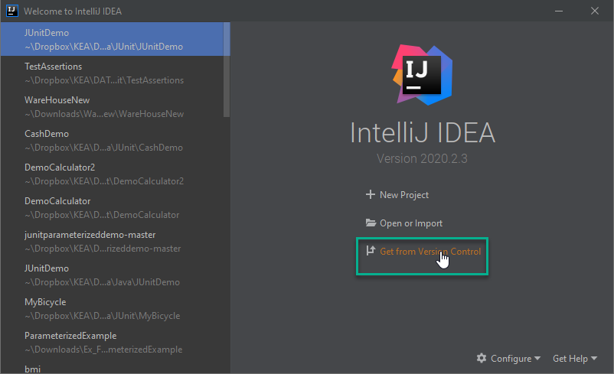
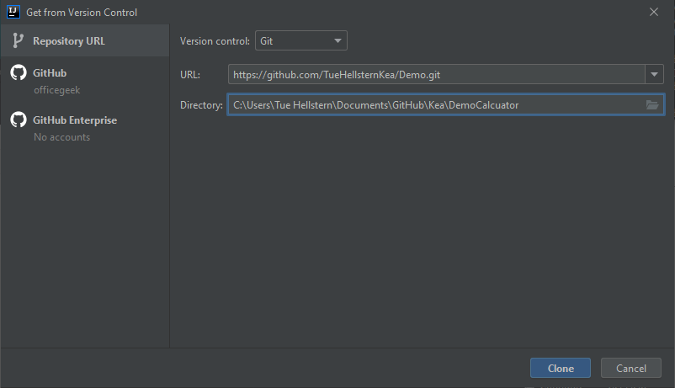
IntelliJ Github
https://github.com/TueHellsternKea/DemoCalculator.git
Den mappe hvor du har dine Git repositories

Slide 11
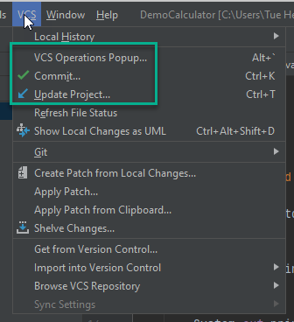
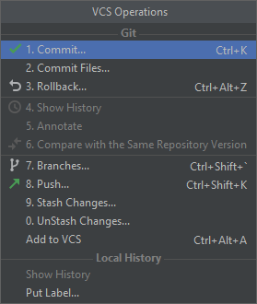

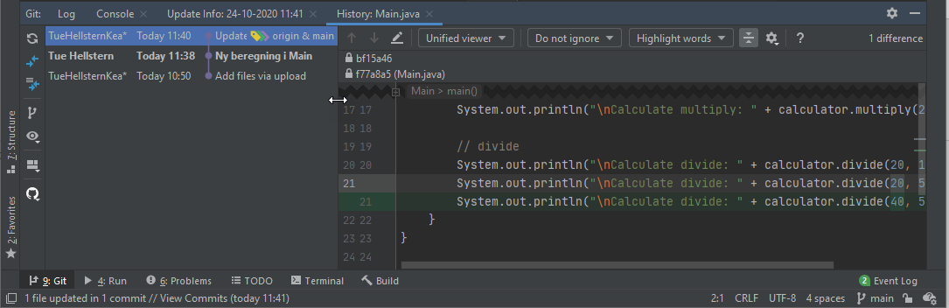
IntelliJ Github

Slide 12
Git command
git add .
git commit -m “Besked….”
git clone https://<username>:<token>@github.com/<username>/<project_name>.git
git push https://<username>:<token>@github.com/<username>/<project_name>.git
git pull
git log
git status

